Slide 1
Docker

Slide 2
What is Docker
Docker is a containerization platform that packages your application and all its dependencies together in the form of a docker container to ensure that your application works seamlessly in any environment.

Slide 3
Docker Container
Docker Container is a standardized unit which can be created on the fly to deploy a particular application or environment. It could be an Ubuntu container, CentOs container, etc. to full-fill the requirement from an operating system point of view. Also, it could be an application oriented container like Jenkins container or a Tomcat-Ubuntu container etc.

Slide 4
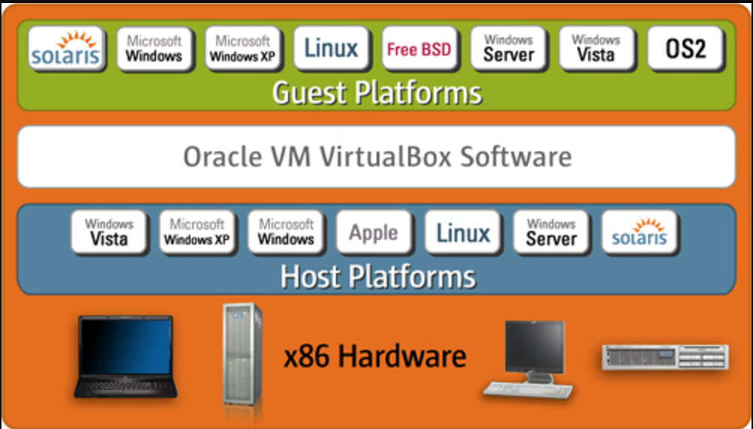
Virtual Machines

Slide 5
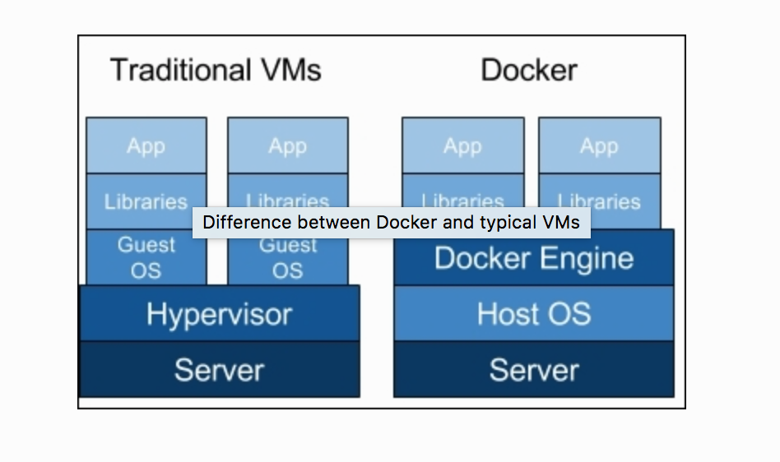
Docker vs Virtual Machine

Slide 6
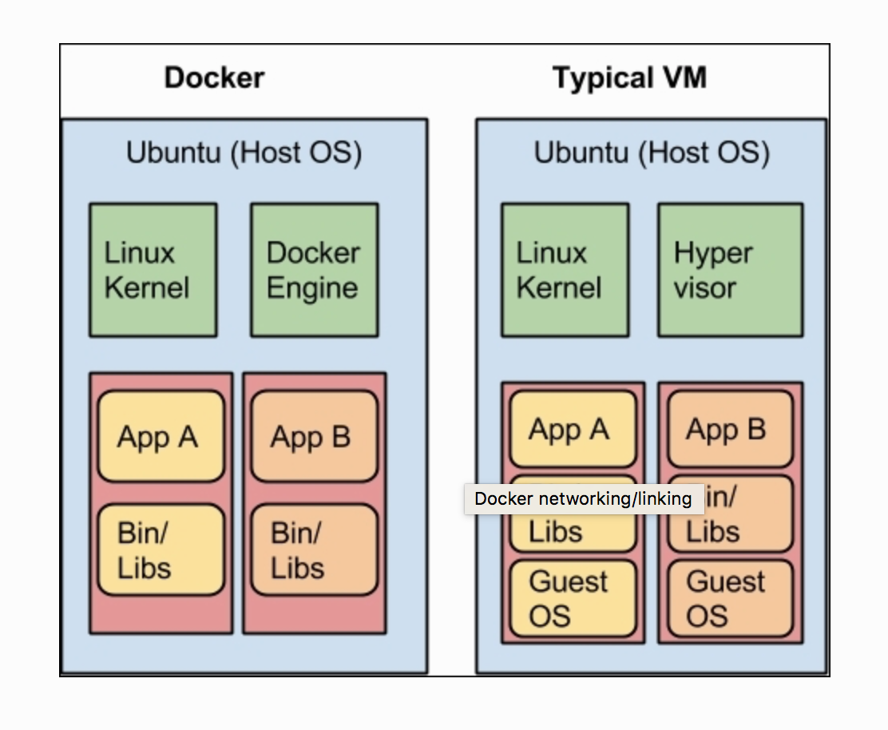
Docker vs Virtual Machine

Slide 7
Pros and Cons
Pros:
Size of the applications
Initialization time
Application Integrations
Cons:
Monitoring
Platform Dependent
Docker Sprawl

Slide 8
Docker Engine
Docker is a platform for developers and sysadmins to develop, ship, and run applications. Docker lets you quickly assemble applications from components and eliminates the friction that can come when shipping code. Docker lets you get your code tested and deployed into production as fast as possible.
Docker consists of:
The Docker Engine - our lightweight and powerful open source containerization technology combined with a work flow for building and containerizing your applications.
Docker Hub - our SaaS service for sharing and managing your application stacks.

Slide 9
Docker Engine is a client-server application with these major components:
A server which is a type of long-running program called a daemon process (the dockerd command).
A REST API which specifies interfaces that programs can use to talk to the daemon and instruct it what to do.
A command line interface (CLI) client (the docker command).

Slide 10
The Docker daemon
The Docker daemon (dockerd) listens for Docker API requests and manages Docker objects such as images, containers, networks, and volumes. A daemon can also communicate with other daemons to manage Docker services.

Slide 11
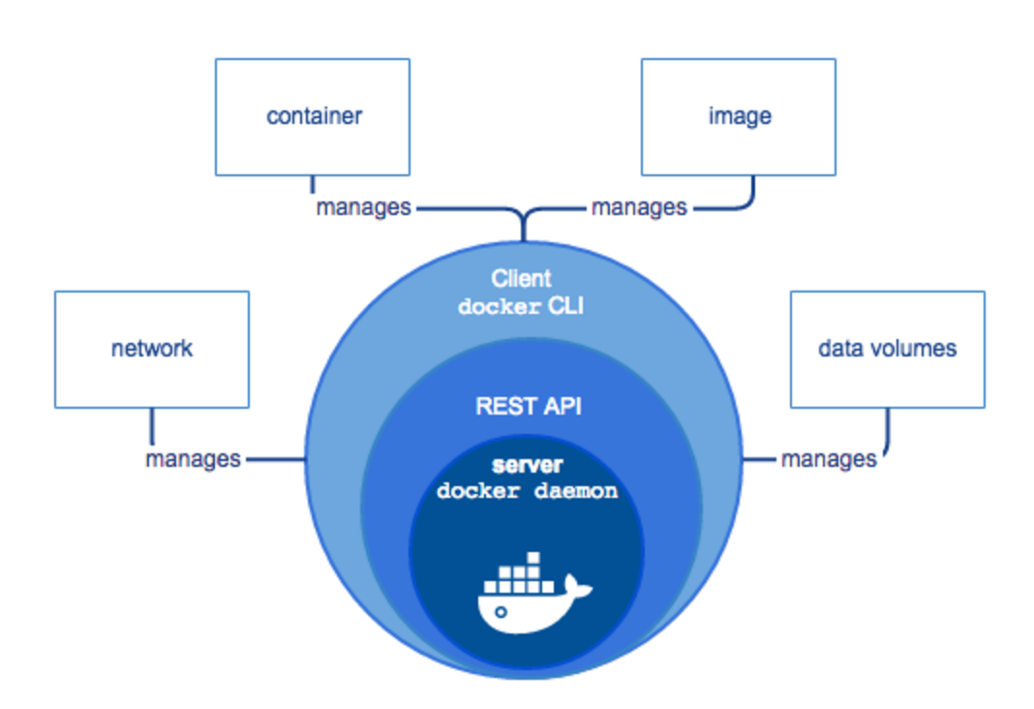
Docker Architecture

Slide 12
The Docker client
The Docker client (docker) is the primary way that many Docker users interact with Docker. When you use commands such as docker run, the client sends these commands to dockerd, which carries them out. The docker command uses the Docker API. The Docker client can communicate with more than one daemon.

Slide 13
Docker registries
A Docker registry stores Docker images. Docker Hub and Docker Cloud are public registries that anyone can use, and Docker is configured to look for images on Docker Hub by default. You can even run your own private registry. If you use Docker Datacenter (DDC), it includes Docker Trusted Registry (DTR).
When you use the docker pull or docker run commands, the required images are pulled from your configured registry. When you use the docker push command, your image is pushed to your configured registry.
Docker store allows you to buy and sell Docker images or distribute them for free. For instance, you can buy a Docker image containing an application or service from a software vendor and use the image to deploy the application into your testing, staging, and production environments. You can upgrade the application by pulling the new version of the image and redeploying the containers.

Slide 14
Docker objects
When you use Docker, you are creating and using images, containers, networks, volumes, plugins, and other objects. This section is a brief overview of some of those objects.

Slide 15
Docker Images
An image is a read-only template with instructions for creating a Docker container. Often, an image is based on another image, with some additional customization. For example, you may build an image which is based on the ubuntu image, but installs the Apache web server and your application, as well as the configuration details needed to make your application run.
You might create your own images or you might only use those created by others and published in a registry. To build your own image, you create a Dockerfile with a simple syntax for defining the steps needed to create the image and run it. Each instruction in a Dockerfile creates a layer in the image. When you change the Dockerfile and rebuild the image, only those layers which have changed are rebuilt. This is part of what makes images so lightweight, small, and fast, when compared to other virtualization technologies.

Slide 16
Docker Containers
A container is a runnable instance of an image. You can create, run, stop, move, or delete a container using the Docker API or CLI. You can connect a container to one or more networks, attach storage to it, or even create a new image based on its current state.
By default, a container is relatively well isolated from other containers and its host machine. You can control how isolated a container’s network, storage, or other underlying subsystems are from other containers or from the host machine.
A container is defined by its image as well as any configuration options you provide to it when you create or run it. When a container stops, any changes to its state that are not stored in persistent storage disappears.

Slide 17
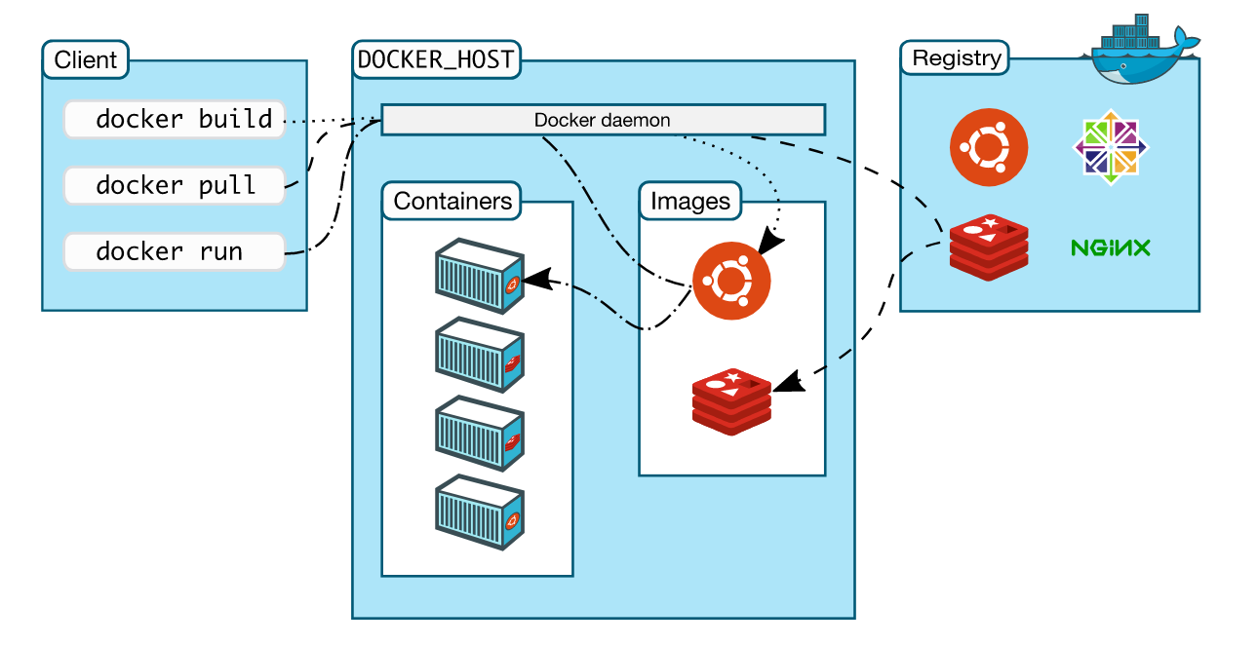
The big picture

Slide 18
Installing Docker
SET UP THE REPOSITORY
* Update the apt package index:
$ sudo apt-get update
* Install packages to allow apt to use a repository over HTTPS:
$ sudo apt-get install \
apt-transport-https \
ca-certificates \
curl \
software-properties-common
*Add Docker’s official GPG key:
$ curl -fsSL https://download.docker.com/linux/ubuntu/gpg | sudo apt-key add -
*Verify that the key fingerprint is:
9DC8 5822 9FC7 DD38 854A E2D8 8D81 803C 0EBF CD88
sudo apt-key fingerprint 0EBFCD88
pub 4096R/0EBFCD88 2017-02-22
Key fingerprint = 9DC8 5822 9FC7 DD38 854A E2D8 8D81 803C 0EBF CD88
uid Docker Release (CE deb) <docker@docker.com>
sub 4096R/F273FCD8 2017-02-22

Slide 19
Use the following command to set up the stable repository:
$ sudo add-apt-repository \
“deb [arch=amd64] https://download.docker.com/linux/ubuntu \
$(lsb_release -cs) \
Stable”
* Update the apt package index.
$ sudo apt-get update
* Install the latest version of Docker CE:
$ sudo apt-get install docker-ce
*Verify that Docker CE is installed correctly by running the hello-world image.
$ sudo docker run hello-world

Slide 20
Assignment
Follow the steps in this PPT to install the Docker on your Virtual Box.
Take a screen shot showing the docker run hello-world example.
Save it to a word document and upload it to wiselin’s Github repository.

